Slide 1

Student Health & Human Services
Office of Human Relations, Diversity & Equity
June 2022

Slide 2

Would you rather...
Be poor and work at a job you love
Be rich and work at a job you hate

Slide 3
Objectives
Learn about Shavuot
1
Identify the importance of Shavuot in the Jewish faith and why it is celebrated
2
Discuss the difference of this holiday and others regarding giving and receiving.
3

Slide 4
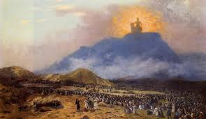
What is Shavuot?
The Jewish holiday – which means "weeks" in Hebrew.
Referred to as the "Feast of Weeks".
Celebrates the Jews receiving the Torah (the Jewish bible) from God on Mount Sinai.
It is the end of a seven-week (49-day) count called the Omer that starts during Passover, the holiday where Jews partake in seders and remember how they were freed from Egyptian slavery.

Slide 5
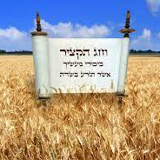
About Shavuot
Coincides with the grain harvest of early summer
It’s one of three pilgrimage festivals mentioned in the Torah
In Ancient Israel, males were commanded to appear before God in Jerusalem to bring offerings of the first fruits from their harvest.

Slide 6
When is it celebrated?
Shavuot is celebrated on the sixth day of the Hebrew month of Sivan.
In the 21st century, it usually falls between May 15 and June 14.

Slide 7
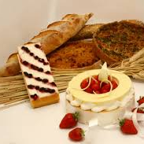
How is Shavuot celebrated?
The most common activity is to hear the reading of the Ten Commandments from a Torah scroll
Some people stay up all night studying the Torah to prove their worthiness, excitement, and enthusiasm towards the Torah and eating dairy.
Some communities eat dairy because it is thought to have been plentiful at that time.

Slide 8
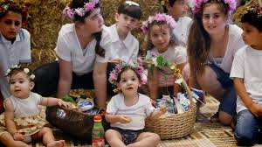
Other Customs
Reading from the book of Ruth and filling synagogues with fresh flowers.
This is done to represent the miraculous blooming of flowers on Mt. Sinai, just before the giving of the Torah.

Slide 9
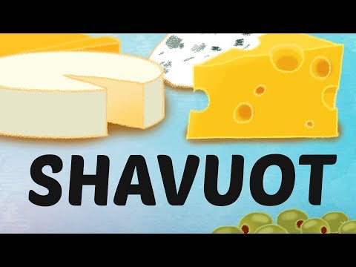
What is Shavuot? All About the Jewish Holiday for Torah and Learning
Notes:
https://youtu.be/XEcwkaIjpmk
Running Time: 4:08

Slide 10

Let's Chat – Check Out
The video mentions that Shavuot is about receiving and learning, which is very different from other religious holidays, where they are about giving.
What do you think about this? Are there similar holidays or special occasions in your culture or religion?

Slide 11
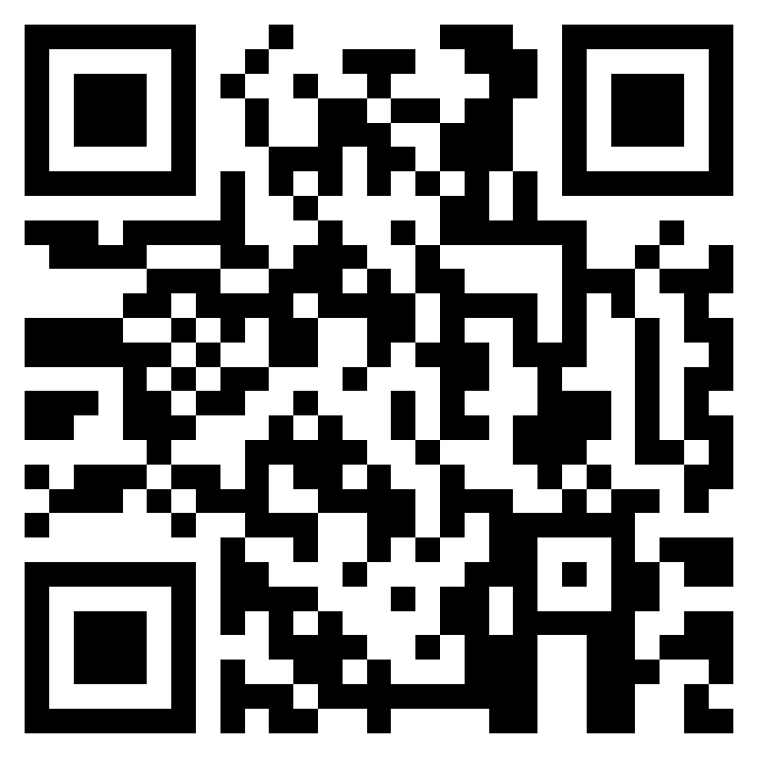
Teacher Survey
Notes:
Teacher please scan the QR code or click the link below to complete a brief feedback survey.
https://forms.office.com/r/i9UqyyxzTT

Slide 12

Human Relations, Diversity & Equity

